Slide 1

World Happiness
Raymond Bell, George Tomaras, Shaunghnessy Robertson

Slide 2


Slide 3
Background
The World Happiness Report is a landmark survey of the state of global happiness that ranks 156 countries by how happy their citizens perceive themselves to be.
The WHR is examined in terms GDP per capita, health & life expectancy, generosity, social support, and freedom.

Slide 4
Data
Kaggle
World Happiness Report 2015 - 2019
Happiness Score:
Economy (GDP)
Social Support
Health (Life Expectancy)
Freedom
Trust
Generosity

Slide 5
Hypotheses
Null Hypothesis: There is no difference between the extent which each of these factors impact happiness score: economy, health & life expectancy, generosity, social support, and freedom.
Alternative Hypothesis: There is a difference between the extent which each of these factors impact happiness score: economy, health & life expectancy, generosity, social support, and freedom

Slide 6
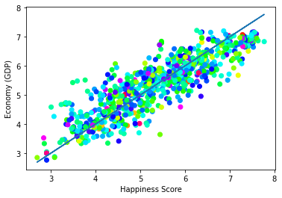
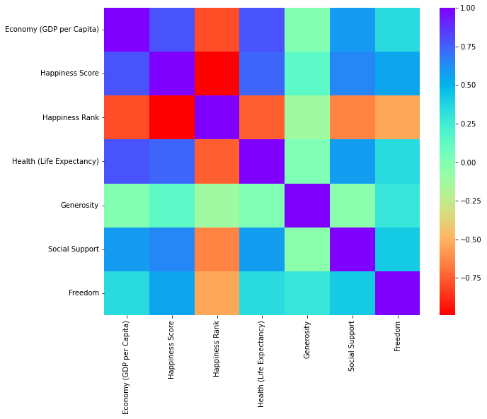
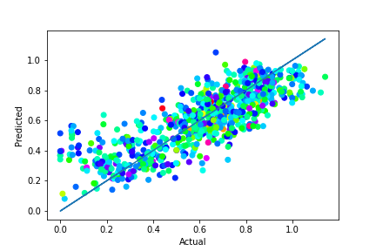
Correlation (Heatmap)

Slide 7
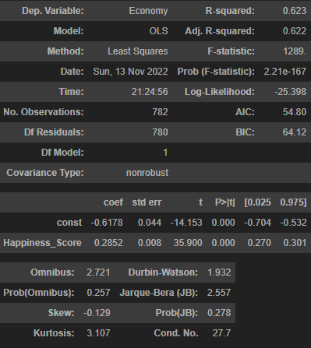
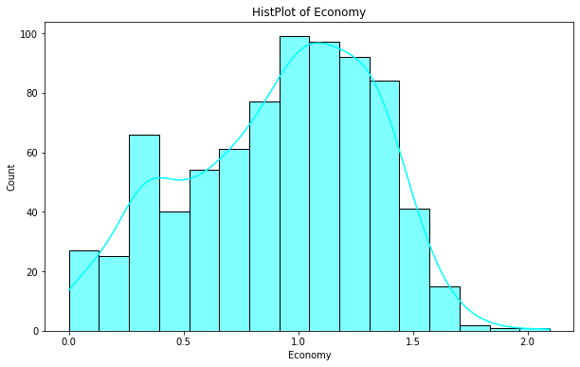
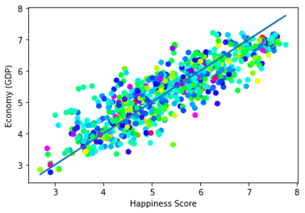
Prediction Model

Slide 8
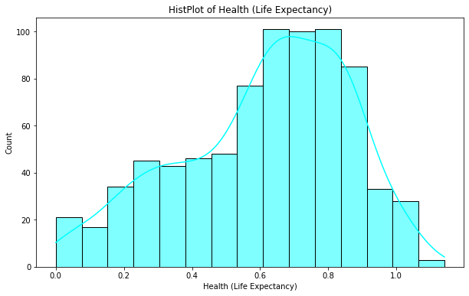
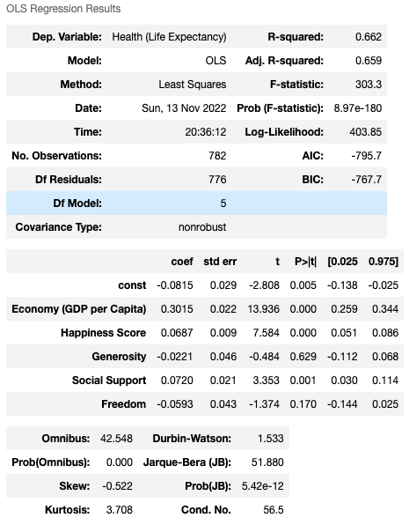
Prediction Model

Slide 9
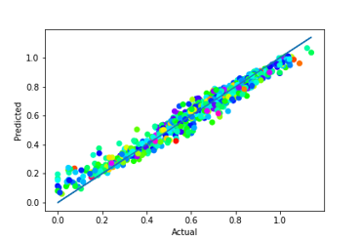
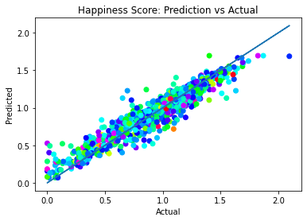
Random Forest

Slide 10
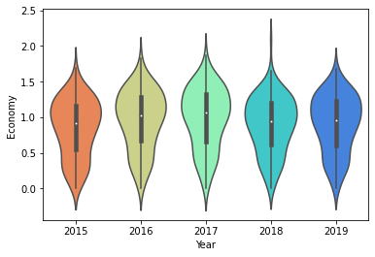
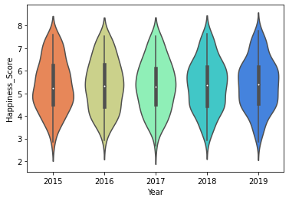
T-Test
2016 and 2019
T-statistic = 2.65
P-value < 0.05
2016 and 2019
T-statistic = -0.72
P-value > 0.05

Slide 11
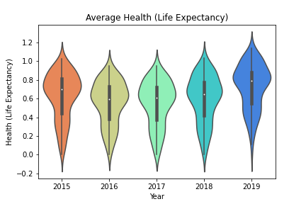
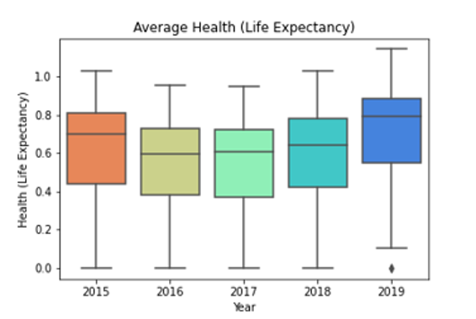
T-Test
T-statistic = -11.7946
P-value < 0.05

Slide 12
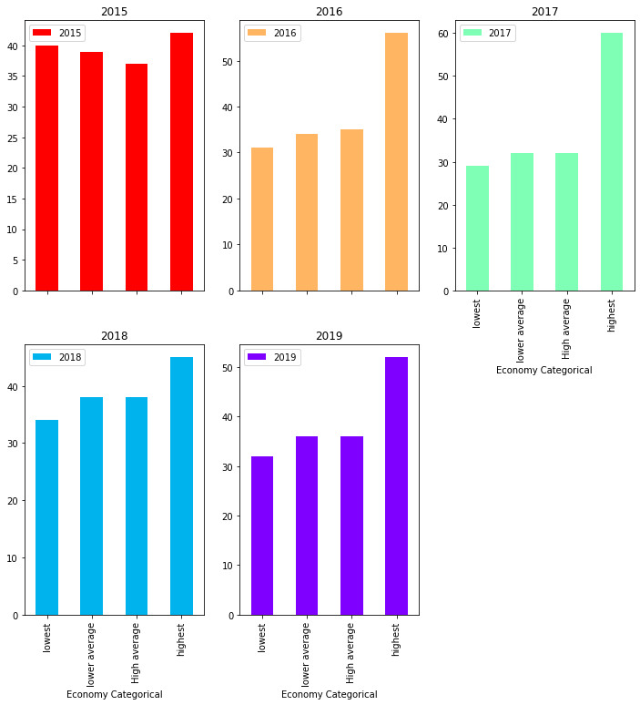
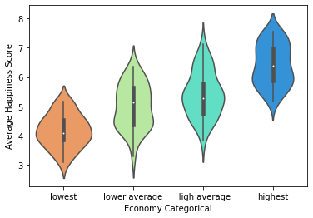
Economy Categorical

Slide 13
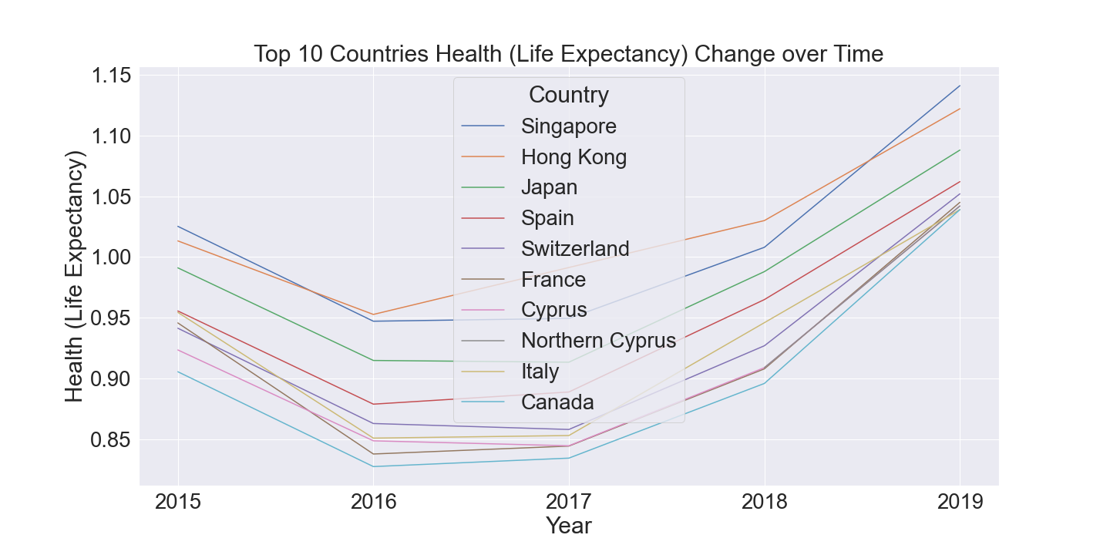
Health (Life Expectancy) change over time

Slide 14
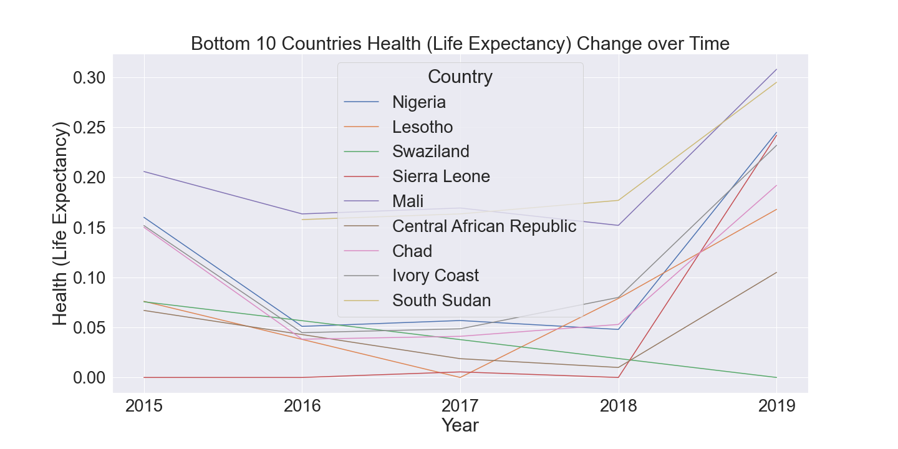
Health (Life Expectancy) change over time

Slide 15
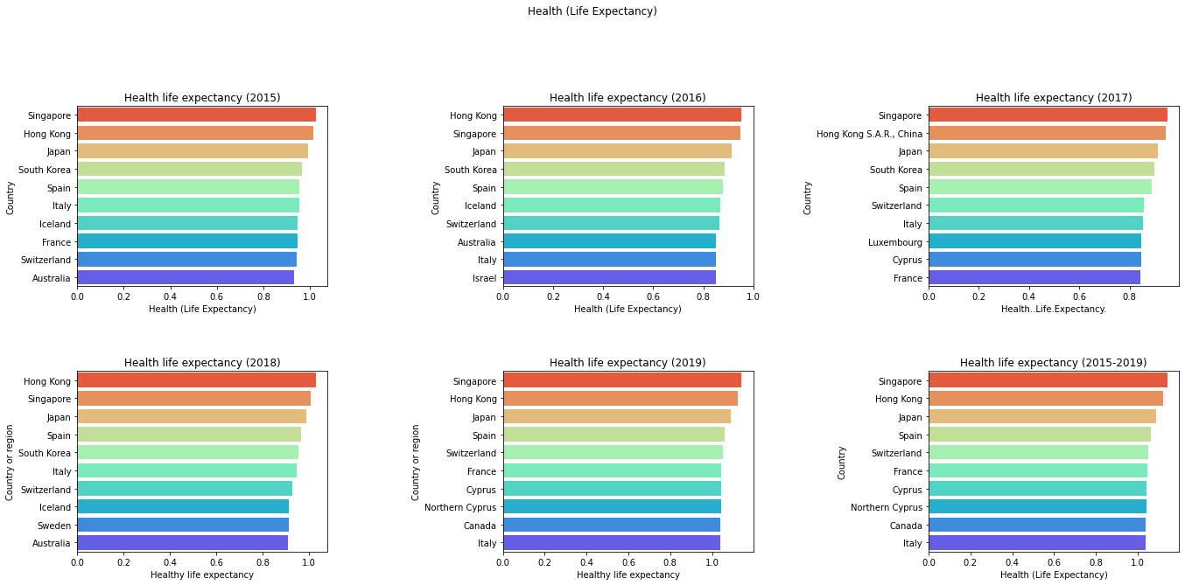
Top 10 Countries Life Expectancy by Year

Slide 16
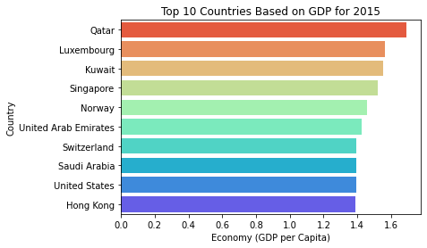
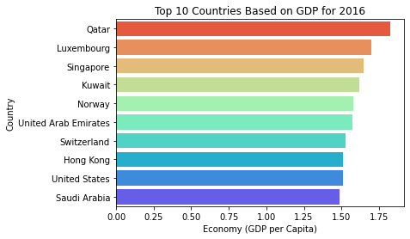
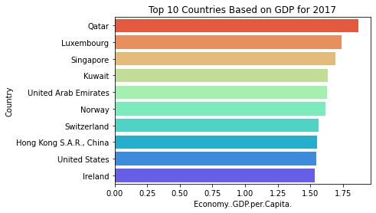
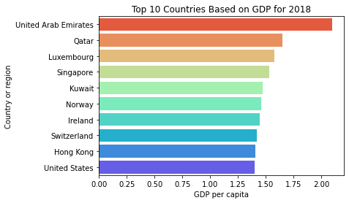
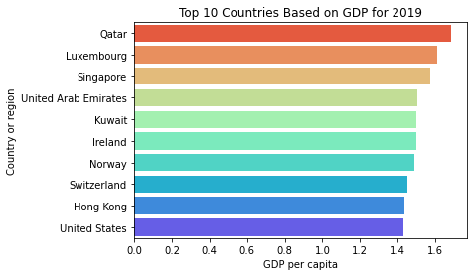
Top 10 Countries GDP by Year

Slide 17
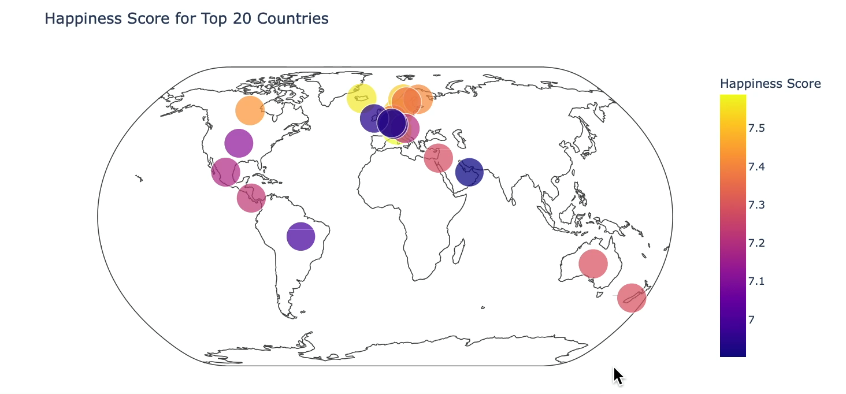
Happiness Score for Top 20 Countries

Slide 18
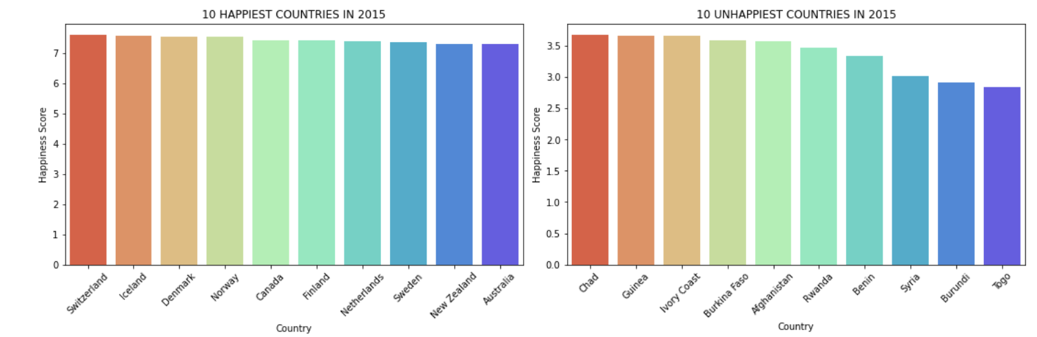
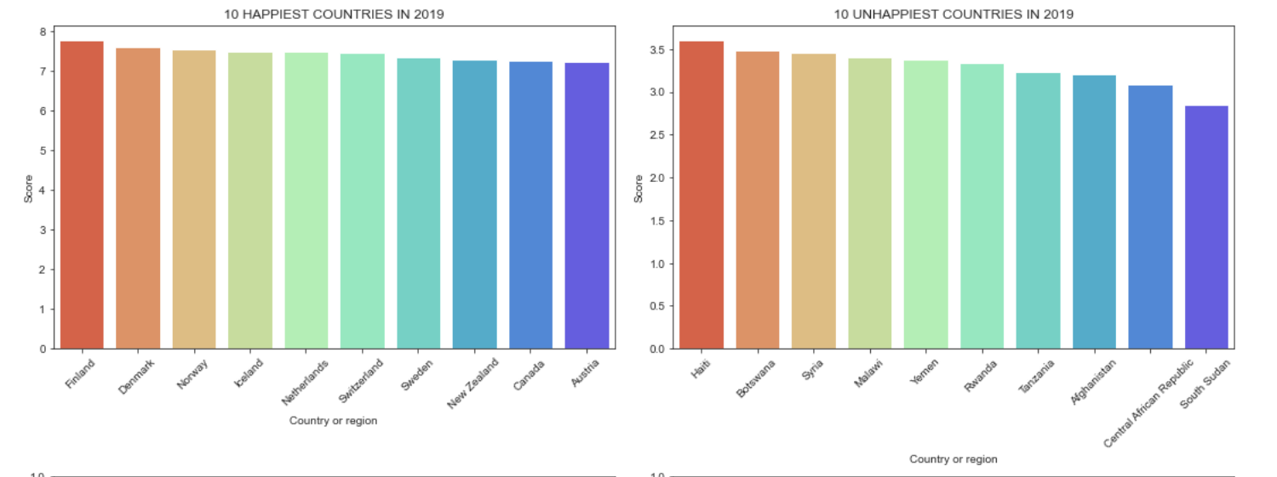
Happiest Countries vs Unhappiest Countries

Slide 19


Conclusion
Null Hypothesis: There is no difference between the extent which each of these factors impact happiness score: economy, health & life expectancy, generosity, social support, and freedom.
Alternative Hypothesis: There is a difference between the extent which each of these factors impact happiness score: economy, health & life expectancy, generosity, social support, and freedom

